Slide 1
Efficient Inventory Management in E-Commerce
TEAM MEMBERS:
1.SAI LOKESH REDDY NANDAVARAPU (nandavarapu.s@northeastern.edu)
2.HIMANI GUPTA (gupta.him@northeastern.edu)
3.SHALIN EDWARD (shalinedward.f@northeastern.edu)
4.MANASVINI KOTTAPALLY (kottapally.m@northeastern.edu)

Slide 2
PROBLEM STATEMENT
In the fast-paced world of e-commerce, maintaining accurate inventory levels is critical for meeting customer demand, optimizing supply chain operations, and maximizing profitability. Most businesses continue not to have a single system that can facilitate real-time visibility over stocks from all channels; therefore, when the need arises, they end up getting stock statuses that are incorrect, fulfillment issues arise, and customers are dissatisfied. Stockouts lead to lost sales, while overstocking results in costly storage and tied-up capital. As a result, businesses struggle to maintain customer satisfaction, subject to higher operational costs, and lack the agility required to adapt to rapid changes in market demand. In an e-commerce company, inventory optimization is required so that the potential benefits can be utilized completely to impact revenue and growth prospects.

Slide 3
OBJECTIVES
The main objective is to create a stock management system for E-Commerce platform.
To prevent stockouts or overstock scenarios, to maintain exact inventory levels.
To cut down on handling time and expenses, optimize the picking, packing, and shipping procedures.
To increase profitability, reduce holding costs and increase turnover rates.
Ensure timely fulfillment of orders to enhance customer experience and loyalty.
Make accurate demand predictions and modify inventory levels based on data analytics.
Modify inventory plans in response to shifting consumer preferences, seasonal demands, and market trends.
Reduce waste and enhance environmental effect by optimizing inventory levels.

Slide 4
BUSINESS PROBLEM AND HOW IT’S ADDRESSED WITH THIS SOLUTION
E-commerce businesses frequently encounter significant challenges in inventory management, which can adversely affect their operations and customer satisfaction. One major issue is the accuracy of the level of inventory. Incorrect recording of the company's stock has often made it difficult for companies to avoid stockouts of popular items or overstocking of less-demanded products that may lead to lost sales and increased holding costs and delays in order fulfillment.
Many e-commerce platforms operate with isolated databases, making it difficult to achieve a comprehensive view of inventory, sales, and customer behaviors. Besides, supplier management is also complicated, since many suppliers is difficult and time-consuming to manage, it will impact the availability of products and efficiency of procurement. Lastly, all the factors mentioned above lead to poor customer. As a result, the E-commerce platform requires a management system that will improve the real-time inventory tracking, comprehensive data integration, supplier performance management and overall customer experience.
Managing data in a relational database can help us maintain data integrity, reduce data redundancy, and make it easier to use. A relational database can also provide security, accuracy, consistency and flexibility to add, update or delete the data. It facilitates a clear understanding of the data structure, ensures effective database design, and enhances communication among stakeholders.
This Business solution will help us to implement an effective inventory management solution that can transform an e-commerce business, leading to enhanced operational efficiency, improved customer satisfaction, and increased profitability. The solution not only addresses current challenges but also positions the business for sustainable growth and competitiveness in the ever-evolving e-commerce landscape. By continuously monitoring and refining inventory practices, the business can achieve long-term success and adapt to changing market dynamics.

Slide 5
CONSTRAINTS AND VALIDATION
Implement a validation rule to ensure that order quantities cannot be less than 1.
Ensure the customer email follows standard email format (e.g., example@domain.com), and should not be empty.
Check that the selling price does not exceed the maximum retail price when updating product prices.
When inventory for a product reaches the reorder level, a notification or alert should trigger the auto-order process.
Ensure that any form submission for customer details enforces mandatory fields (first name, last name, email).
Non-negative integer stock levels and product price.

Slide 6
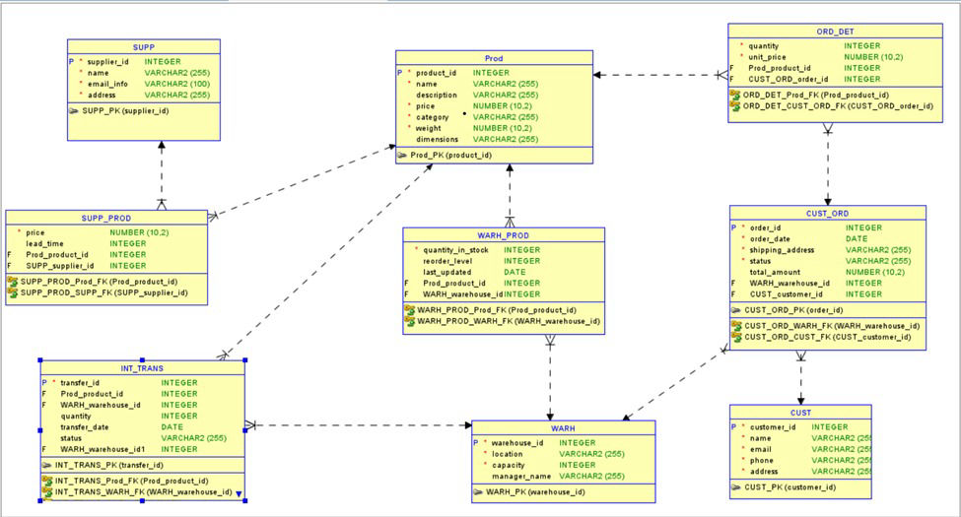
ER- DIAGRAM

Slide 7
Database Tables
Customer
Customer_Order
Inventory_Transfer
Order_Details
Product
Supplier
Supplier_Product
Warehouse
Warehouse_Product

Slide 8
PROJECT VIEWS
View Name | Description | Assigned Users
Stock_Level_View | Shows stock levels of products in each warehouse. | Inventory Manager, Supplier Manager, Inventory User
Order_Summary_View | Provides an overview of customer orders with customer and warehouse information. | Sales Manager
Supplier_Product_Info_View | Lists suppliers, products, pricing, and lead time. | Supplier Manager
Inventory_Transfer_History_View | Provides the history of product transfers between warehouses. | Inventory Manager, Inventory User
Customer_Order_Details_View | Displays details of each customer order with itemized products. | Sales Manager
Stock_Reorder_View | Highlights products requiring reordering based on current stock levels and supplier information. | Inventory Manager, Supplier Manager
Product_Stock_Gap_View | Displays product demand vs. stock availability and identifies stock gaps. | Inventory Manager, Sales Manager

Slide 9
Procedures
PalaceOrder
ReplenishStock
TransferInventory
CheckLowStock

Slide 10
DEFINE SECURITY (USER LEVEL ACCESS, PERMISSIONS)
Object Type | Object Name | Supervisor | Inventory Manager | Sales Manager | Supplier Manager | Inventory User | Package User
Table | Warehouse Product | Full Access | Read/Write | None | Read | Read | None
Table | Customer Order | Full Access | None | Read/Write | None | None | None
Table | Order Details | Full Access | None | Read/Write | None | None | None
Table | Product | Full Access | Read | Read | None | Read | None
Table | Supplier | Full Access | None | None | Read/Write | None | None
Table | SEQ ORDER ID | Full Access | Select | Select | None | Select | None
Table | ValidateUserAccess | Execute | Execute | Execute | Execute | Execute | None
Table | CalculateOrderTotal | Execute | None | Execute | None | None | None
Sequence | FindWarehouseWithStock | Execute | None | Execute | None | None | None
Function | CheckStockStatus | Execute | None | None | Execute | Execute | None
Function | GetCurrentStock | Execute | Execute | None | None | Execute | None
Function | IsProductInWarehouse | Execute | Execute | None | None | Execute | None
Function | UtilityPackage | Execute | Execute | Execute | Execute | Execute | Execute
Package | InventoryManager | None | Execute | None | None | None | Execute
Package | SalesManager | None | None | Execute | None | None | Execute
Package | SupplierManager | None | None | None | Execute | None | Execute
Package | InventoryUser | None | None | None | None | Execute | Execute
Procedure | PlaceOrder | Execute | None | Execute | None | None | Execute
Procedure | ReplenishStock | Execute | Execute | None | None | None | Execute
Procedure | CheckLowStock | Execute | None | None | Execute | Execute | Execute
Procedure | TransferInventory | Execute | None | None | None | None | Execute
Procedure | AddSupplier | Execute | None | None | None | None | None

Slide 11
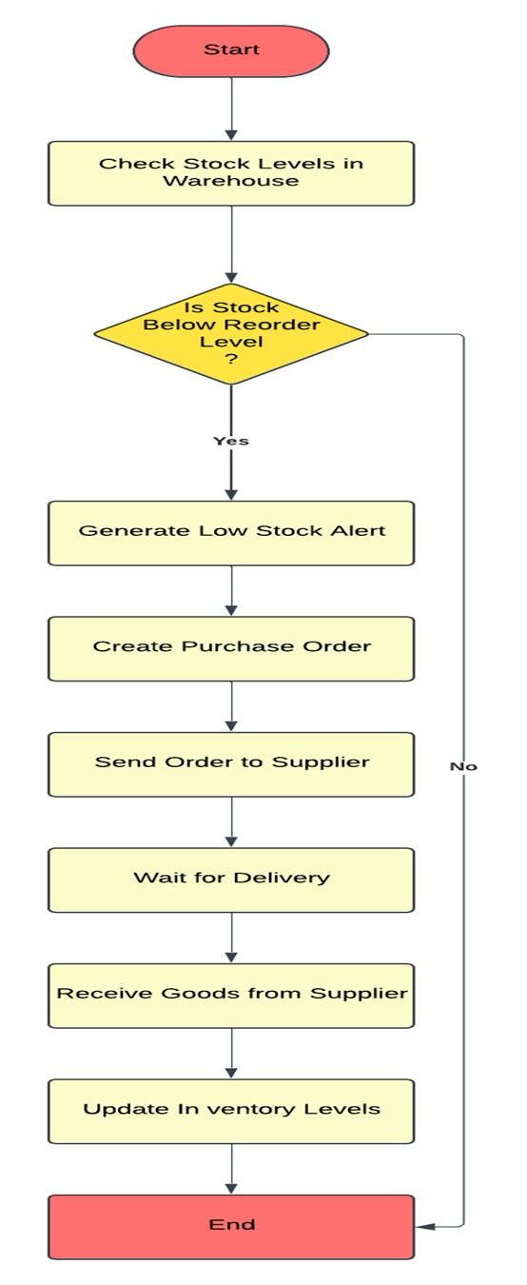
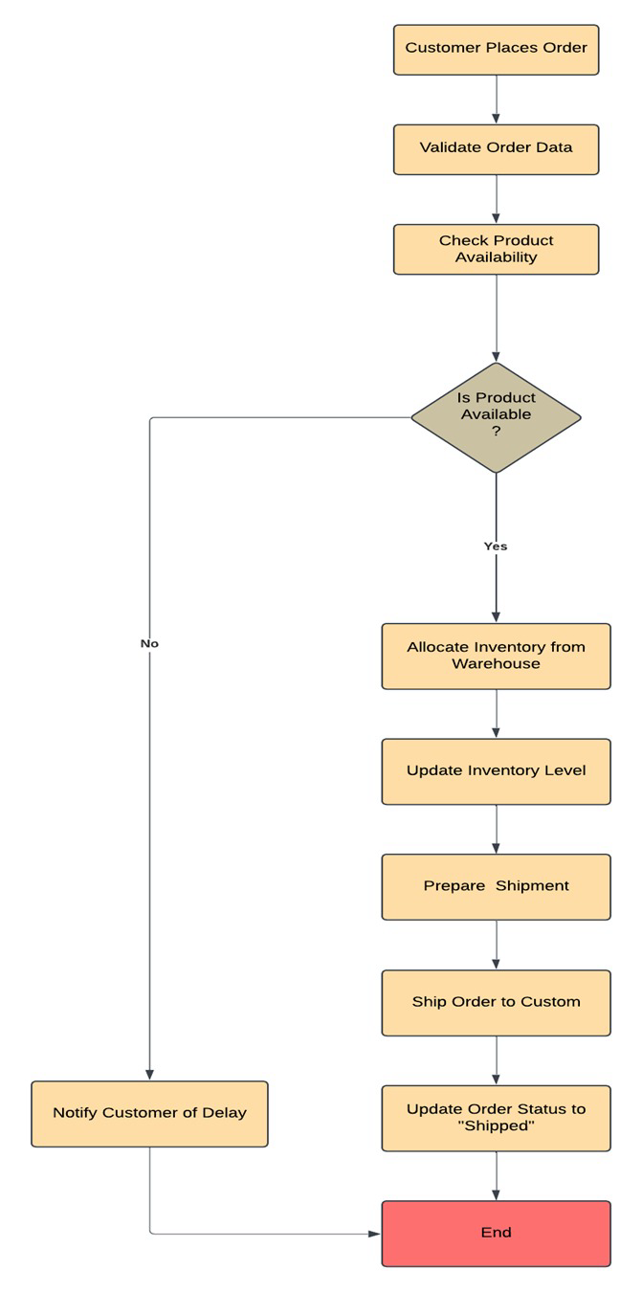
DFDD
Stock Monitoring and Reordering Process
Order Processing and Fulfillment Process

Slide 12
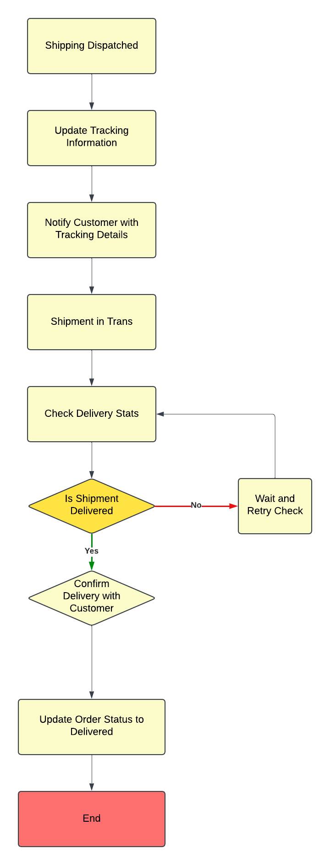
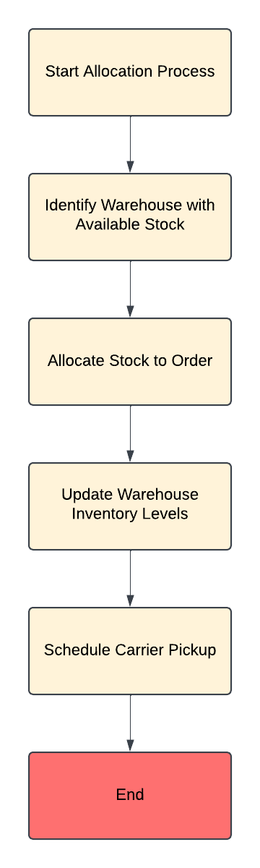
Supplier Reordering Process
Inventory update and Warehouse Allocation Process

Slide 13
Contributions
Sai Lokesh Reddy Nandavarapu: Took the lead in creating the utility package, which encapsulates all stored procedures into a single package for organized functionality. Designed and implemented a package user with access restricted solely to the packages. Additionally, created the supervisor user, sequences, and key functions such as calculatedOrderTotal and findWarehouseWithStock. Played a pivotal role in user access validation.
Manasvini Kottapally: Focused on developing packages and triggers, including low stock and inventory transfer status triggers. Worked on user roles by creating and dropping them. Merged sequences into DML operations, updated and consolidated reports, and created the kg_SalesManager package. Also managed runtime error handling across the application.
Himani Gupta: Contributed to database structure by dropping and recreating tables with constraints. Generated comprehensive reports such as the Top-Selling Product Report and Supplier Performance Report. Developed key functions like GetCurrentStock and ProductInWarehouse, and created the pkg_InventoryManager package. Also emphasized runtime error handling and ensured robust error management within her package implementation.
Shalin Edward: Designed and implemented database views, truncated tables, and inserted test data via the DML file. Generated detailed reports, including the Top-Selling Products in Warehouse Report, High-Value Customers and Products Report, and the Inventory Transfer Impact Report. Developed functions such as CheckStockStatus and created the pkg_SupplierManager and pkg_InventoryUser packages, incorporating thorough error-handling mechanisms to ensure smooth operations.

Slide 14
DEMO

